Slide 1
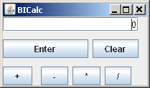
Next Programming Assignment Maybe…
You are a manufacturer of calculators
calculators that represent very large numbers
your core product uses a GUI front-end to Java BigIntegers
Yuge!
application
product

Slide 2
But…
To stay ahead of your competitors, there are other Java numerical types you could use, but they don’t implement the same interface
so a Java generic won’t work
divide() for BigInteger is not the same as that for BigDecimal, etc.
Need a 2-class framework to encode this family of designs

Slide 3
Final Design Should Look Like
application
framework
BI-Plugin
D-Plugin
now review basic steps

